Slide 1
DBMS WEEK 6 & 7
Paper code: CS593

Slide 2
The SQL UNION Operator
The UNION operator is used to combine the result-set of two or more SELECT statements.
Each SELECT statement within UNION must have the same number of columns
The columns must also have similar data types
The columns in each SELECT statement must also be in the same order
Syntax:
SELECT column_name(s) FROM table1 UNION SELECT column_name(s) FROM table2;

Slide 3
UNION ALL - Operation
The UNION operator selects only distinct values by default. To allow all union duplicate values also, use UNION ALL:
Syntax:
SELECT column_name(s) FROM table1 UNION ALL SELECT column_name(s) FROM table2;

Slide 4
SQL UNION With WHERE Clause
The following SQL statement returns the German cities (only distinct values) from both the "Customers" and the "Suppliers" table:
SELECT City, Country FROM Customers WHERE Country='Germany' UNION SELECT City, Country FROM Suppliers WHERE Country='Germany' ORDER BY City;

Slide 5
SQL UNION ALL With WHERE Clause
The following SQL statement returns the German cities (duplicate values also) from both the "Customers" and the "Suppliers" table:
SELECT City, Country FROM Customers WHERE Country='Germany' UNION ALL SELECT City, Country FROM Suppliers WHERE Country='Germany' ORDER BY City;

Slide 6
The SQL HAVING Clause
The HAVING clause was added to SQL because the WHERE keyword could not be used with aggregate functions.
Syntax:
SELECT column_name(s) FROM table_name WHERE condition GROUP BY column_name(s) HAVING condition ORDER BY column_name(s);

Slide 7
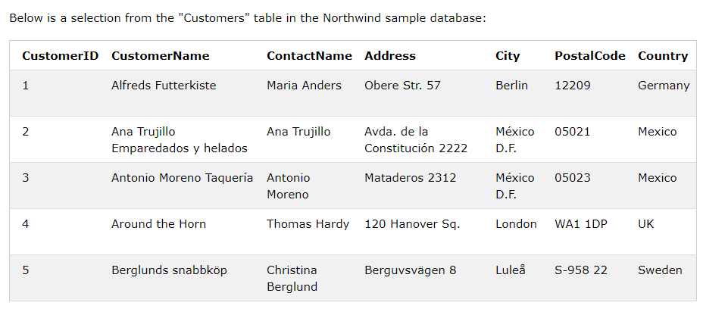
The following SQL statement lists the number of customers in each country. Only include countries with more than 5 customers:
SELECT COUNT(CustomerID), country FROM Customers GROUP BY Country HAVING COUNT(CustomerID) > 5;

Slide 8
MYSQL MINUS Operator
MINUS compares results of two queries and returns distinct rows from the first query that aren’t output by the second query.
Syntax:
SELECT column_list_1 FROM table_1
MINUS
SELECT columns_list_2 FROM table_2;

Slide 9
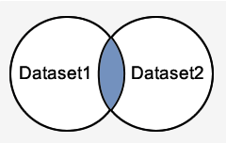
MYSQL INTERSECT Operator
The INTERSECT query will return the records in the blue shaded area. These are the records that exist in both Dataset1 and Dataset2.

Slide 10
INTERSECT - Syntax
SELECT expression1, expression2, ... expression_n FROM tables
[WHERE conditions]
INTERSECT
SELECT expression1, expression2, ... expression_n FROM tables
[WHERE conditions];
E.g.
SELECT ID, NAME, AMOUNT, DATE FROM CUSTOMERS
LEFT JOIN ORDERS ON CUSTOMERS.ID = ORDERS.CUSTOMER_ID
INTERSECT
SELECT ID, NAME, AMOUNT, DATE FROM CUSTOMERS
RIGHT JOIN ORDERS ON CUSTOMERS.ID = ORDERS.CUSTOMER_ID;

Slide 11
Few more numeric functions
ABS() Function: Returns absolute value
Example: SELECT ABS(-243.5);
Result: 243.5
DIV Function: Integer division (10/5):
SELECT 10 DIV 5;
Result: 2

Slide 12
EXP() Function: Return e raised to the power of 1:
SELECT EXP(1);
GREATEST() Function: Return the greatest value of the list of arguments
Example: SELECT GREATEST(3, 12, 34, 8, 25);
LEAST() Function: Return the smallest value of the list of arguments
Example: SELECT LEAST(3, 12, 34, 8, 25);

Slide 13
LN() Function: Natural Logarithm of a number
Example: SELECT LN(2);
LOG() Function: SELECT LOG(2);
Syntax: LOG(number) or LOG(base, number)
A number. Must be greater than 0
The base of number. Must be greater than 1
LOG10() Function:
Return the base-10 logarithm of 2:
SELECT LOG10(2);
Syntax: SELECT LOG10(number);

Slide 14
LOG2() Function: Return the base-2 logarithm of 6
SELECT LOG2(6);
Syntax: LOG2(number);
MAX() Function:
Find the price of the most expensive product in the "Products" table:
SELECT MAX(Price) AS LargestPrice FROM Products;
MIN() Function:
Find the price of the cheapest product in the "Products" table:
SELECT MIN(Price) AS SmallestPrice FROM Products;

Slide 15
MOD() Function: Returns remainder
Syntax: Select MOD(x,y);
Example: Select MOD(18,4);
POW() Function: Return 4 raised to the second power
Syntax: Select POW(x,y);
Example: SELECT POW(4, 2);
RADIANS() Function: Convert a degree value into radians
SELECT RADIANS(180);
3.141592653589793

Slide 16
RAND() Function: Return a random decimal number (no seed value - so it returns a completely random number >= 0 and <1)
Syntax: SELECT RAND();
SIGN() Function: Return the sign of a number.
Example: SELECT SIGN(-255.5);
Result: -1
This function will return one of the following:
If number > 0, it returns 1
If number = 0, it returns 0
If number < 0, it returns -1

Slide 17
SubQuery Subqueries with the SELECT Statement
Syntax:
SELECT column_name [, column_name ]
FROM table1 [, table2 ]
WHERE column_name
OPERATOR (SELECT column_name [,column_name ] FROM table1 [, table2 ] [WHERE])
E.g.
SELECT * FROM CUSTOMERS WHERE ID
IN (SELECT ID FROM CUSTOMERS WHERE SALARY > 4500) ;

Slide 18
Subqueries with the INSERT Statement
Consider a table CUSTOMERS_BKP with similar structure as CUSTOMERS table. Now to copy the complete CUSTOMERS table into the CUSTOMERS_BKP table, you can use the following syntax.
E.g. INSERT INTO CUSTOMERS_BKP SELECT * FROM CUSTOMERS
WHERE ID IN (SELECT ID FROM CUSTOMERS) ;

Slide 19
Subqueries with the UPDATE Statement
Assuming, we have CUSTOMERS_BKP table available which is backup of CUSTOMERS table. The following example updates SALARY by 0.25 times in the CUSTOMERS table for all the customers whose AGE is greater than or equal to 27.
E.g.
UPDATE CUSTOMERS SET SALARY = SALARY * 0.25 WHERE
AGE IN (SELECT AGE FROM CUSTOMERS_BKP WHERE AGE >= 27 );

Slide 20
Subqueries with the DELETE Statement
Assuming, we have a CUSTOMERS_BKP table available which is a backup of the CUSTOMERS table. The following example deletes the records from the CUSTOMERS table for all the customers whose AGE is greater than or equal to 27.
E.g.
DELETE FROM CUSTOMERS WHERE AGE IN (SELECT AGE FROM CUSTOMERS_BKP WHERE AGE >= 27 );

